Slide 1
LAYOUT OF THE ARDUINO UNO

Slide 2
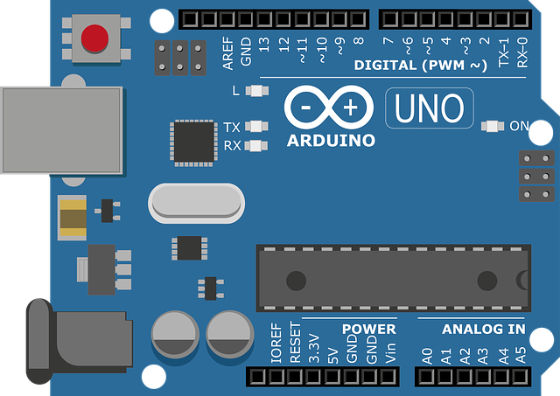
ATMEL CHIP

Slide 3
The biggest advantage is its ready to use structure.;
Library of examples present inside the Arduino IDE;
Syntax based on C and C++;
Compatible with major OSs;
Accessibility, availability and affordability.

Slide 4
Arduino or Raspberry Pi ?
Arduino can be powered using a battery pack, while Raspberry Pi cannot;
Connection with sensors is simple and easy;
Arduino can provide onboard storage;
Former is a plug and play device;
Former is affordable in comparsion.

